Slide 1
CREATING MARKETS
IFC’s Green Buildings Market Transformation Program
Notes:
Today I’ll speak about how IFC is helping to create a market for green buildings where it has largely not existed in the past. Our Green Buildings Market Transformation Program is based on the premise that there is a strong business case for green buildings everywhere in the world, including in emerging markets. What is essential, however, is a holistic approach where everyone works together with the understanding that we are all profitable when it comes to green buildings, whether we design or develop them, make governance or investment decisions, or buy, sell, live or work in them. This concept is essential for everyone to foster, socialize and support, including all of us who are here today.

Slide 2

IFC: A MEMBER OF THE WORLD BANK GROUP
IBRD
International
Bank for Reconstruction and Development
IDA
International Development Association
IFC
International Finance Corporation
MIGA
Multilateral Investment Guarantee Agency
ICSID
International Centre for Settlement of Investment Disputes
Loans to
middle-income
and credit-worthy,
low-income country governments.
Interest-free loans and grants to governments
of poorest
Countries.
Solutions in private sector development.
Guarantees of foreign direct investment’s non-commercial risks.
Conciliation and arbitration of investment disputes.
Notes:
I’ll start with background about IFC, a member of the World Bank Group. We are the largest development institution in the world focused on the private sector in emerging markets, providing investment, advice and resource mobilization. In fiscal year 2018, IFC’s long-term investments totaled more than $23 billion, including funds mobilized from other investors.

Slide 3






WE PRIORITIZE INVESTMENT IN FIVE CLIMATE-SMART SECTORS.
CLEAN ENERGY
CLIMATE-SMART CITIES
GREEN BUILDINGS
GREEN FINANCE
CLIMATE-SMART AGRI
Investments in large-scale renewable energy projects with a focus on frontier markets.
Sustainable Cities platform with project preparation
and technical assistance.
Investments in resource-efficient commercial
and residential buildings.
Climate finance through 750 client banks and development of capital market solutions.
Focus on animal protein, land and crops, and food waste.
Notes:
Our climate program targets five business sectors to capitalize on efficiencies and technologies that will shape climate business well into the future, which includes green buildings. IFC has been tracking climate change investments since 2005, and since then we have invested $25 billion in long-term finance for climate, and mobilized an additional nearly $19 billion through syndicated loans and public-private partnerships. In fiscal year 2019, 29% of IFC’s investments were climate-related.

Slide 4
IFC HAS INVESTED AND MOBILIZED NEARLY $4.4 BILLION IN GREEN BUILDINGS SINCE 2014.
Notes:
Our green buildings program includes direct investments from our own account and mobilization through our banking partners, totaling nearly $4.4 billion since 2014.

Slide 5
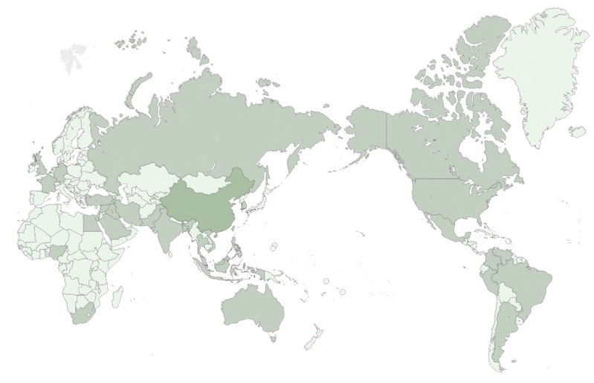
IN TERMS OF SHEER VOLUME OF SQUARE METERS, CHINA IS PROJECTED TO DOMINATE BUILDING GROWTH THROUGH 2025.
Notes:
Most building growth is happening in East and South Asia, with China dominating. By 2025, 60 percent of the world’s building volume will happen in East and South Asia, 40 percent of which will be in China.

Slide 6
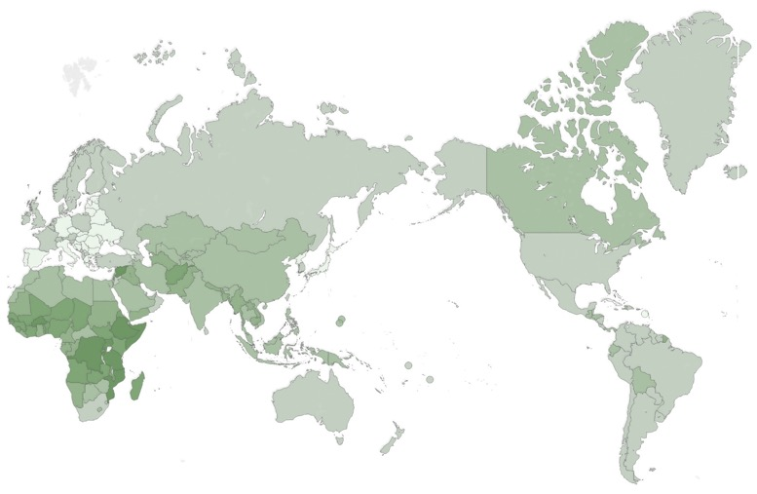
THE BUILDING GROWTH RATE UNTIL 2025 WILL BE HIGHEST IN EMERGING MARKET COUNTRIES, PARTICULARLY IN AFRICA.
Notes:
Our investment program is responding to the fact that most green building growth until 2025 will occur in emerging markets, with the highest growth rate occurring in Africa.

Slide 7
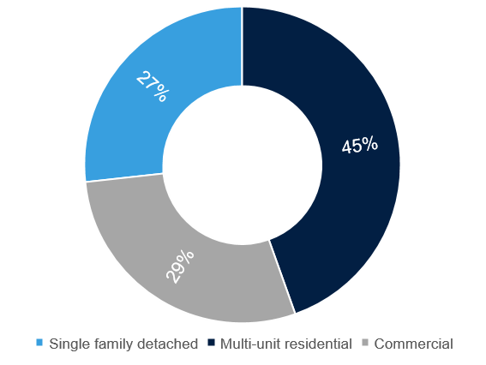
NEARLY THREE-QUARTERS OF BUILDING GROWTH IN EMERGING MARKETS WILL BE RESIDENTIAL.
Notes:
Nearly three-quarters of this growth will occur in residential buildings, indicated here in shades of blue. Resource-efficient design can secure emission cuts at a low cost and lock in energy and water savings for decades, everywhere in the world. We can reduce the amount of energy-related GHGs from buildings, which today stands at 19 percent of all GHG emissions, according to the Intergovernmental Panel on Climate Change (IPCC). We can also reduce the amount of electricity that buildings consume, at 40 percent of electricity globally, according to the International Energy Agency (IEA).

Slide 8
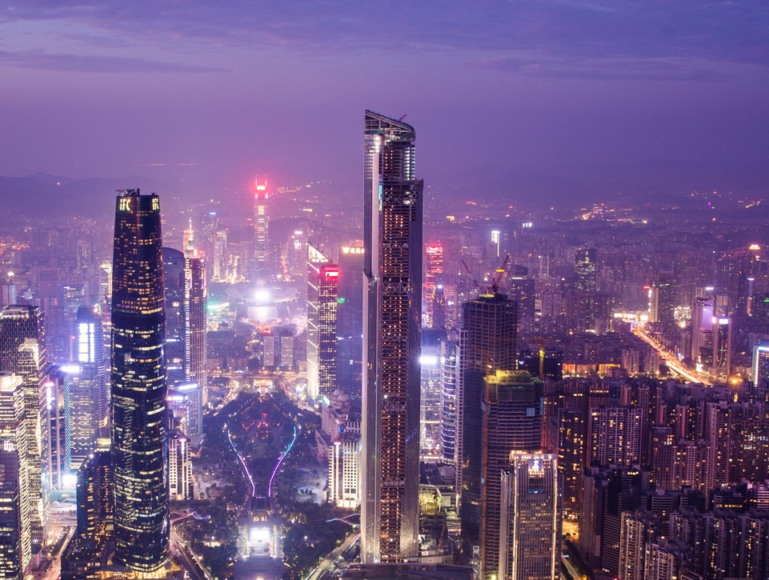
THE GLOBAL INVESTMENT OPPORTUNITY FOR GREEN BUILDINGS: UP TO $16.3 TRILLION BY 2030.
POTENTIAL:
$13 trillion in East Asia.
$1.5 trillion in South Asia.
$900 billion in Latin America.
$400 billion in Eastern Europe.
$150 billion in Sub-Saharan Africa.
Notes:
There is a tremendous opportunity in financing green buildings, to help direct the property sector onto a low-carbon path. And while IFC has started to realize this opportunity with the support of our clients and banking partners, we know that we can’t do it alone. Imagine that in 2016, green building investments worldwide were $406 billion. We predict growth of 40 times this volume, or up to $16.3 trillion, by 2030. This opportunity is fueled by urbanization, increased incomes, and population growth that the United Nations predicts will continue throughout the century, potentially topping 10 billion people. Our future depends upon whether buildings are resource-efficient.
So how can we ensure this new construction is designed and built in a resource-efficient way?

Slide 9
EACH STAKEHOLDER IN THE GREEN BUILDING CYCLE CLEARLY BENEFITS.
1
2
3
4
Developers
Banks
Governments
Owners
Differentiation & Profit
Volume & Less Risk
Safeguarding & Responsibility
Value & Emotion
Send a positive signal to investors.
Drive profitability that leads to expansion.
Ensure cost control & consistency across properties.
Complement efficiencies in construction and labor.
Contribute to a competitive brand of sustainability.
Lower the capital allocation needed to cover risk.
Gain market share through new products such as green bonds and green mortgages.
Protect from late payments and loan defaults.
Enhance reputation through CSR leadership.
Protection of the under-privileged from utility shocks.
Establishing a healthier and more socially uplifting environment for all.
Conservation of precious natural resources.
Ability to meet NDC commitments as per the Paris Agreement.
Save on utility bills.
Invest in a property that will increase in value.
Create a more comfortable lifestyle.
Inspire pride of ownership.
Protect the planet.
Notes:
When we look at the value that green buildings provide, we see that each stakeholder clearly benefits. Developers can differentiate their properties and profit from the value they are providing to their customers. Banks can achieve greater volumes while taking on less risk. Owners can pay less in utility bills. We’ve seen that our early adopters recognize this healthy paradigm, and embrace it. What is missing, however, is either a financial incentive to drive adoption at a mass market level, or clear evidence of profit at the point of sale. Builders and buyers are reluctant to cover the extra costs of green. So how can we make this algorithm work?

Slide 10
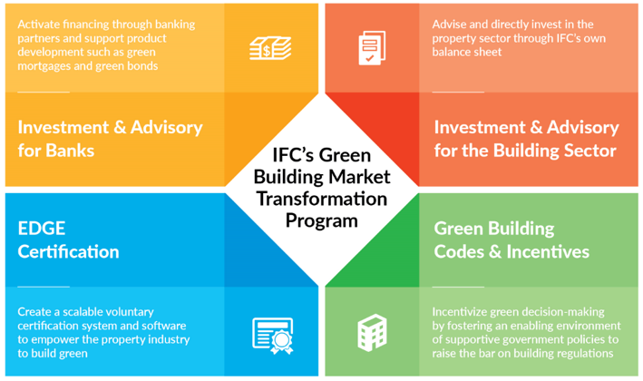
IFC HAS A FOUR-PART STRATEGY TO SUPPORT GREATER INVESTMENT IN GREEN BUILDINGS.
Notes:
IFC’s approach is to concentrate on four areas to catalyze the market and create a virtuous cycle of supply and demand. We’re activating financing through our banking partners and directly investing from our own balance sheet, encouraging the financial sector to offer better terms through such innovations as green bonds. We’re responding to the need for a voluntary program that encourages green building adoption at scale, which is our EDGE green building software and certification program. And we see how important it is to provide expertise and support for policy reform in the form of green building codes and government incentives.

Slide 11
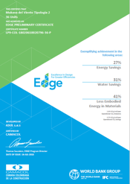
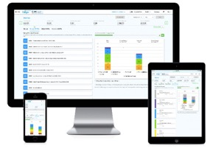
WE CREATED EDGE TO RECOGNIZE THE NEED FOR A MEASURABLE SOLUTION.
20%
Notes:
Let’s start with EDGE. IFC recognized the need for a measurable solution that could turn an ordinary building into a high performing one – before it’s been built. With this aim in mind, IFC created a free, cloud-based software application for choosing the most cost-effective ways to build green, a green building standard of 20% less energy, water, and embodied energy in materials, and a certification system that rewards developers for their green building projects. Our certifiers include green building councils, the consortium of thinkstep-SGS, and GBCI, the operational arm of LEED.

Slide 12
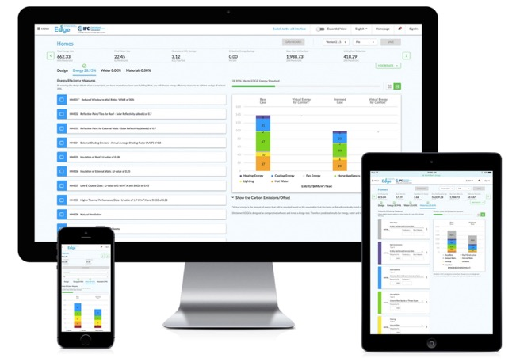
THE FREE EDGE SOFTWARE MAKES IT EASY TO CUT BACK ON THE RESOUCE INTENSITY OF BUILDING DESIGNS.
Notes:
The free EDGE software is the first of its kind in the world. The complexity of the application is hidden beneath the user interface, making it easy for designers to cut back on the resource intensity of their building designs. EDGE shows the extra costs to design green and the payback period through lower utility bills, which is the value that is passed on to the customer.
EDGE can be used to streamline eligibility procedures and the reporting needs of financial institutions as they move towards green investment portfolios, and by developers who wish to differentiate their properties through resource-efficient design.

Slide 13
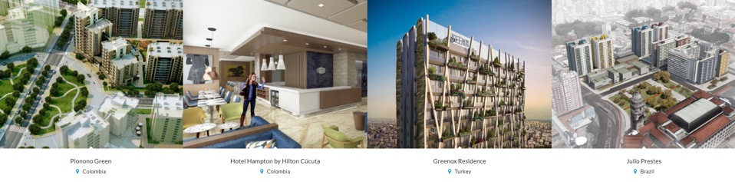
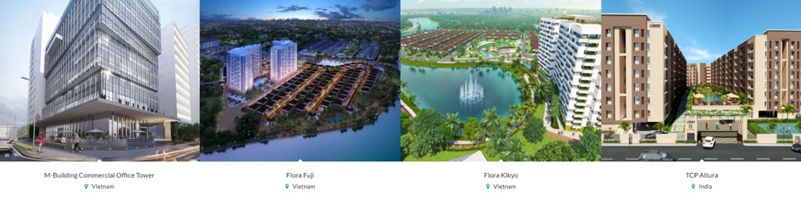
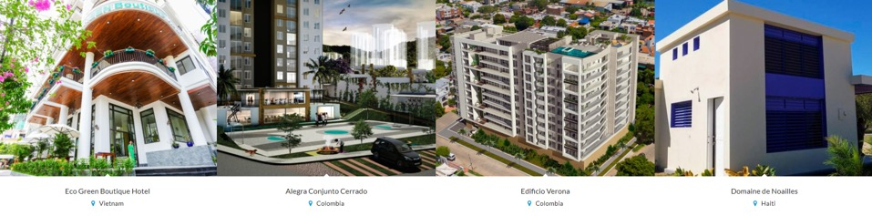
SEVEN MILLION SQUARE METERS HAS BEEN EDGE CERTIFIED.
Notes:
Already more than seven million square meters of residential and commercial space has been certified by early adopters of EDGE, with an additional 14 million square meters registered.

Slide 14








IFC ENCOURAGES GOVERNMENTS TO PROVIDE FISCAL AND
NON-FISCAL INCENTIVES TO SPUR GREEN BUILDING GROWTH.
1
2
3
4
TAX
INCENTIVES
BONUS DENSITY
EXPEDITED PERMITTING
GRANTS & LOANS
Offer a tax credit to developers to offset extra costs.
Allow developers to increase the height of their buildings.
Prioritize permitting for green construction and/or waive permit fees.
Provide grants to cities to incentivize solar power or to developers to subsidize certification costs.
5
6
7
8
TECHNICAL
ASSISTANCE
PUBLIC CAMPAIGNS
NET METERING
LEGISLATION
Train planners, building inspectors, and other government staff on how to audit green buildings.
Work with utilities to enable owners to generate renewable
energy to
the grid.
Generate public support through advocacy efforts.
Bundle a certification standard directly into a new set of codes.
Notes:
Now let’s take a look at the role of governance, which is another part of IFC’s four-part strategy. Governments can provide “carrots” in the form of incentives, which don’t always have to be fiscal, such as expedited permitting or height allowances. They can also raise public awareness about the benefits of green building ownership through public outreach campaigns, and can even bundle a certification standard such as EDGE within their green building codes.

Slide 15
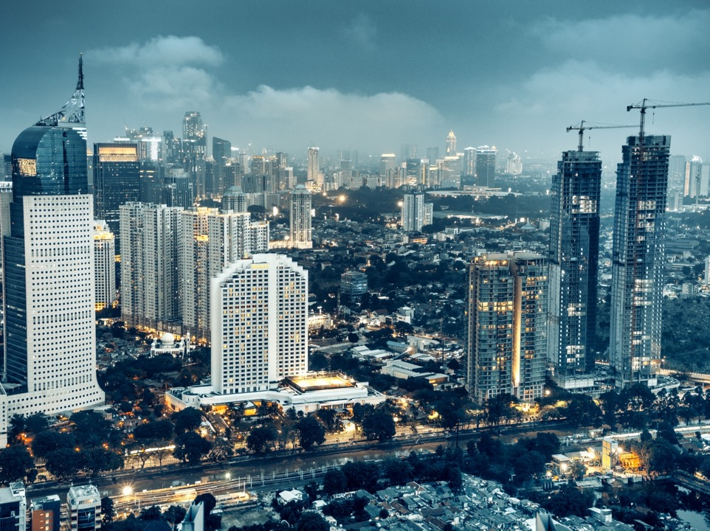
CASE STUDY: JAKARTA GREEN BUILDING CODES
GOAL OF ACHIEVING 30% REDUCTION IN ENERGY, WATER AND CO₂ EMISSIONS BY 2030
POTENTIAL:
1,084,262 metric tons of CO₂ emissions reduction.
1,406,641 MWh of energy savings.
$117,172,248 of energy cost savings.
Notes:
In tandem, municipal and national governments can create, implement and enforce green building codes. IFC has supported several countries in raising the bar on the regulatory front, including Indonesia. The goal for the nation’s capital is to reach 30% reduction on energy, water and CO₂ emissions by 2030. All new buildings must comply with the code, with the goal of 60% compliance in the existing buildings space. Already 392 buildings with 25 million square meters of floor space are in compliance in Jakarta.

Slide 16
IFC IS A LEADER IN THE GREEN BOND INDUSTRY, WHICH IS PROJECTED TO REACH US$250 BILLION THIS YEAR.
Source: Climate Bonds Initiative, Moody’s
Notes:
Next let’s look at the role of finance. The green bond industry is emerging as a critical instrument for raising capital for climate-smart projects, including green buildings. Here’s how it works: a green bond attracts investors who are interested in supporting climate-smart financing. Proceeds support green projects, and investors are paid back when the bond matures. Banks, corporations, and municipalities can all issue green bonds.
As you can see, the market has grown exponentially, reaching $168 billion last year. IFC has issued close to $9.3 billion in more than 150 green bonds in 18 currencies. IFC helps in structuring bonds that adhere to the Green Bond Principles, serving as the anchor investor and providing technical support.

Slide 17


EDGE CAN BE USED THROUGHOUT THE GREEN BOND PROCESS.
  EDGE can be used to establish criteria for use of proceeds.
Criteria
  EDGE has been accepted by international bodies as a second opinion, streamlining the process for the selection of assets.
Second Opinion
  EDGE certification ensures an easy compliance process without adding an extra burden on the issuer.
Allocation process
  EDGE supports environmental impact reporting through the EDGE software.
Reporting
Notes:
By using EDGE to determine criteria, gain a second opinion, and allocate financing for projects, green bond investors are assured that a standard has been met by the builder. EDGE also facilitates project reporting to green bond investors, including CO₂ emissions. EDGE was selected as a verification mechanism to provide investor assurance for the Climate Bonds Initiative, which provides eligibility criteria for several categories of climate-related projects, including green buildings.

Slide 18
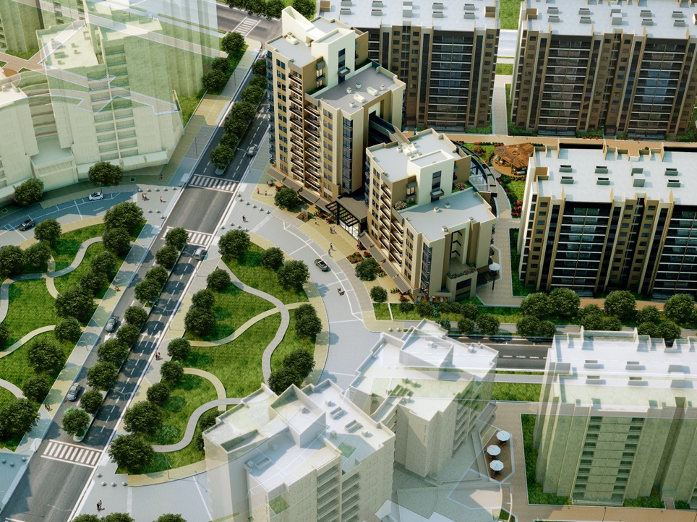
CASE STUDY: BANCOLOMBIA
IFC WAS THE SOLE INVESTOR IN THE COLOMBIAN BANK’S $115 MILLION GREEN BOND.
COLOMBIA ACTUALS:
12,770 homes in the EDGE certification pipeline.
567,000 square meters has been registered for EDGE certification.
More than 1.2 million square meters has been EDGE certified.
Notes:
Bancolombia issued a green bond of $115 million in 2016, with IFC as the sole investor in the bond. The bond issuance has transformed the market, as developers race to take advantage of the discounted construction financing. Davivienda also issued a green bond which IFC financed at $149 million, with projects starting to contribute to the EDGE-certified boom that is happening in Colombia.
Green bonds support green building regulations, which in Colombia are estimated to result in buildings avoiding nearly 190,000 metric tons of GHGs by 2021.

Slide 19
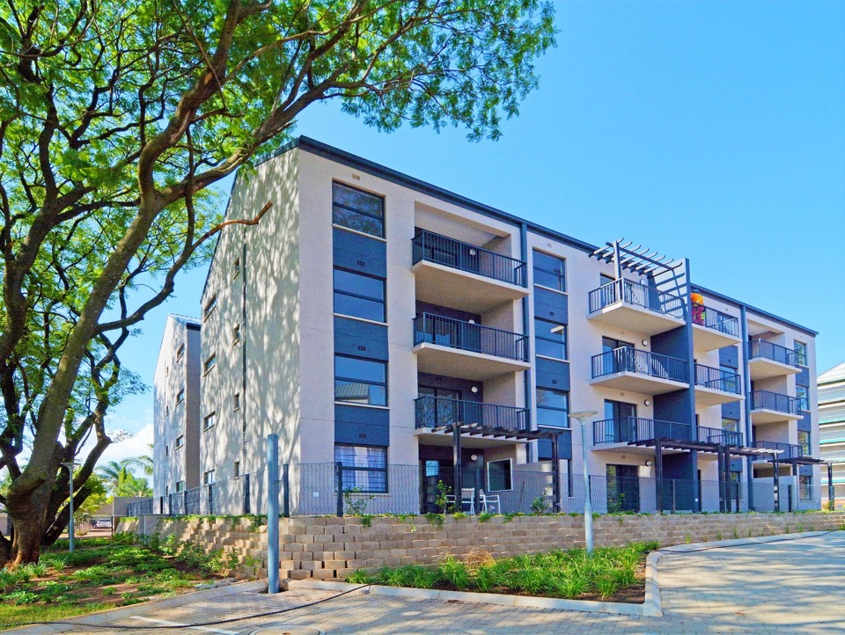
CASE STUDY: INTERNATIONAL HOUSING SOLUTIONS
IFC INVESTED $25 MILLION IN THE REAL ESTATE INVESTMENT FIRM’S GREEN PROPERTY FUND.
ACTUALS:
Nearly 3,000 homes have been EDGE certified.
Nearly 1,500 homes are registered to be certified.
More than 20 tonnes of CO₂ per year will be eliminated from the atmosphere.
Notes:
IFC also invests in real estate investment firms such as South Africa’s International Housing Solutions, which finance and provide technical support for the development of green buildings. The firm finances affordable housing developers who are willing to EDGE-certify their properties, and often owns and manages the stock as rentals once the residences are built. The homes have green design solutions such as natural ventilation, smart meters, solar panels, and low-flow plumbing fixtures to help residents cut back on their utility bills. Three thousand homes have been certified by IHS, with another 1,500 registered for certification.

Slide 20
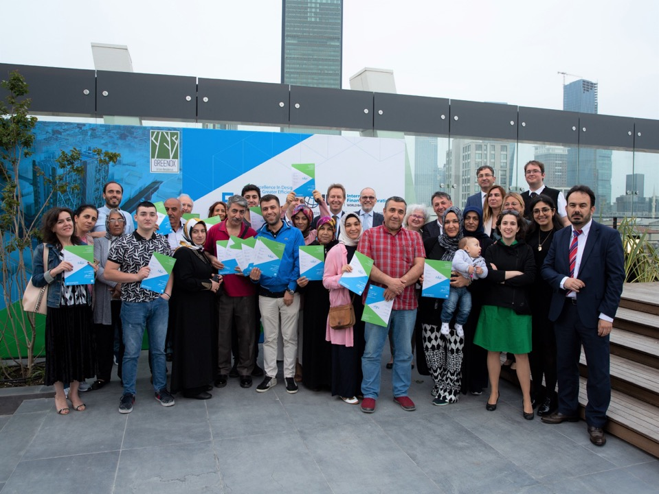
JOIN US AS WE CREATE MOMENTUM TOWARDS A BETTER BUILT ENVIRONMENT FOR ALL.
NEEDS A CALL-TO-ACTION, SUMMARY SLIDE HERE, FUTURE OUTLOOK.
Notes:
IFC’s next focus will be on jumpstarting the green mortgage market with the support of our banking partners, building a treasure trove of data to provide empirical evidence to banks and policy makers on the business case for green buildings, and integrating our green building approach into a broader, climate-smart cities platform. We will continue extending support to governments who are incentivizing green buildings and improving their green building codes, and will scale up our EDGE certification program. And we hope to learn from all of you who are here today about the solutions that you are bringing to reality, and count on you to join us as we create momentum towards a better built environment for all.

Slide 21

IFC’S GREEN BUILDING MARKET TRANSFORMATION PROGRAM IS SUPPORTED BY:
Additional support is provided by Austria, Canada, Denmark, ESMAP, the EU, Finland, GEF, Hungary and Japan.

Slide 22

www.ifc.org

