Slide 1
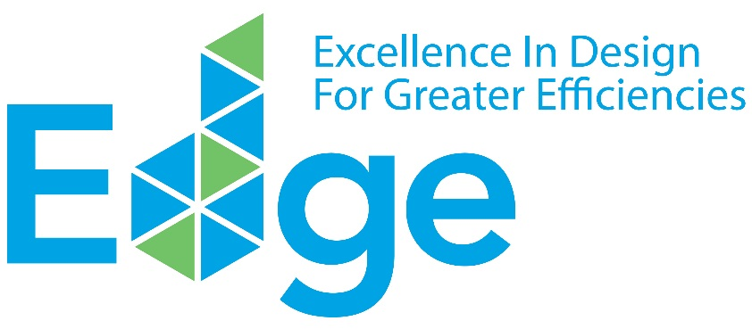
EDGE DISCOVERY WORKSHOP
for Financial Institutions
www.edgebuildings.com
Notes:
Welcome to the EDGE DISCOVERY WORKSHOP for Financial Institutions. Thank you for joining us today.
I am…

Slide 2
IFC IS A MEMBER OF THE WORLD BANK GROUP
________
IBRD
International
Bank for Reconstruction and Development
IDA
International Development Association
IFC
International Finance Corporation
MIGA
Multilateral Investment Guarantee Agency
ICSID
International Centre for Settlement of Investment Disputes
Loans to middle-income and credit-worthy, low-income country governments.
Interest-free loans and grants to governments
of poorest
countries.
Solutions in
private sector development.
Guarantees of foreign direct investment’s non-commercial risks.
Conciliation and arbitration of investment disputes.
Notes:
Our workshop today will cover the following subjects:
Understanding the business case for green building investments
Defining a green building
Summarizing the benefits of EDGE green building certification
Exploring the progress of green buildings in Mexico
Considering how IFC’s EDGE answers the needs of the financial industry
Demoing the EDGE software together
Analyzing case studies of banks investing in green buildings; and
Learning about best practices for launching a green buildings investment program
Before we start, I’ll introduce IFC.
IFC is a member of the World Bank Group.
IFC is focused on solutions for private sector development and part of its mission is to create markets that support climate business.

Slide 3
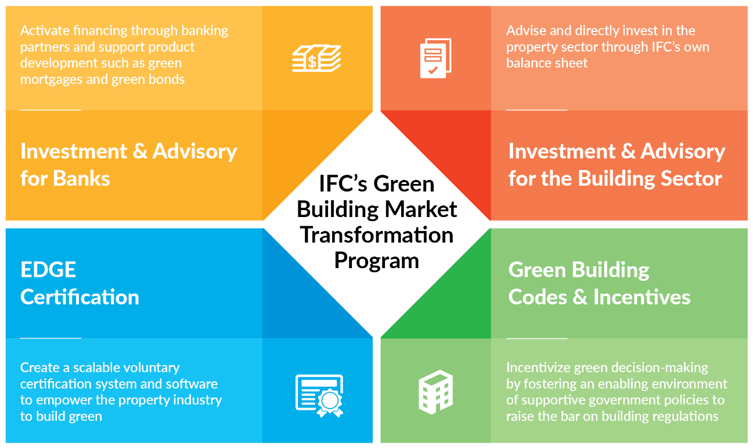
IFC HAS A FOUR-PART STRATEGY TO SUPPORT
GREEN BUILDING GROWTH
________
Source: About EDGE
Notes:
IFC created its Green Building Market Transformation Program to take a leadership role in encouraging a new paradigm where financial institutions, governments, the property sector and consumers all come together to benefit financially through the mainstreaming of green buildings.
The program addresses the gap in the market for an international green building standard that offers a free software solution to help identify the most cost-effective solutions to design and build green, to unlock the potential for a new era of green construction and development.
IFC’s 4-part strategy supports diverting investment to green buildings, through working with banks, investing directly into the building sector, advising governments on green building codes and incentives, and the EDGE certification program.
So far, IFC has mobilized $4.5 billion in green building investments – from its own account and through syndicated loans. Out of that, $876 million – or 20 percent of all investments – is through other financial institutions. IFC believes in the business case for green buildings and how they’re a win-win for all.

Slide 4
IFC’S OFFER FOR FINANCIAL INSTITUTIONS
Long-term loans, warehousing facilities, guarantees and risk-sharing facilities, structured finance,
green bonds
INVESTMENT
Support in identifying or developing your investment pipeline, market intelligence, training for loan officers and developers, sustained technical advice
ADVICE
Global and local marketing campaigns, stakeholder education, capacity building, technical guidance,
promotion of incentives
MARKET CREATION
Notes:
IFC offers advice and investment to financial institutions, so that together we can transform markets.
For its advisory, IFC has in-house technical expertise to share market intelligence and offer support to identify and develop an investment pipeline through connecting relationships. They can also offer training for your loan officers and developer clients.
Their investment products range from debt, equity, and structured finance, to capital markets. They are also able to occasionally draw on blended concessional finance, through the MAGC Program funded by the UK Government.
A foundation for IFC’s work is market creation, including global and local awareness campaigns on the benefits of green building certification, stakeholder education, capacity building, and technical advisory, as well as the promotion of incentives.

Slide 5
Definition of A Green building
________
20%
20%
20%
20%
&
&
20%
MATERIALS
ENERGY
WATER
Better
performance
than THE
local baseline
CertifiABLY GREEN
AS VERIFIED BY
AN INDEPENDENT
THIRD PARTY
Quantified
impact reporting
Notes:
Let’s step back and define what we mean by “a green building.”
A green building needs to be at least 20% more resource efficient than a comparable baseline building in the local market.
A green building must also obtain a local or international standard of green building certification, as verified by an independent party.
Finally, in order to satisfy green finance requirements, projects must have quantified impact reporting – reporting on an individual project basis and on a portfolio basis, such as energy and water saved or reduced GHG emissions.

Slide 6
WHY EDGE: SUMMARIZING THE INVESTMENT CASE FOR BANKS
ADVANTAGES FOR BANKS
Objective
Lower investment risk with both developers and homebuyers
To help banks launch a green buildings investment program for green construction finance, green mortgages, and/or green bonds, enabling greater market share and recognition as a “green bank” while reducing risk.
Capture greater market share
Achieve recognition
Diversify investor base
Reduce reputational and policy risk
Notes:
Let’s summarize the advantages of a green building investment program for the bank, its developer clients, and home buyers.
In the U.S., it’s been proven that green buildings ensure lower investment risk for the financing of both developers and homebuyers. IFC will soon develop an evidence program to explore this with the support of banks such as yourselves across various markets.
There’s the opportunity to become a market leader and gain greater market share. You’ll be able to cross-sell green products between construction finance and mortgages, and be better able to securitize your portfolio to spin it off for future investments.
You will also earn enhanced brand reputation as an innovative and socially responsible bank. Bancolombia, as we’ll soon see in a case study, was named the most sustainable bank in the world by the Dow Jones Sustainability Index, in large part due to their work with green buildings.
After the Paris climate agreement, many international investors are looking for quality green projects. The UN tracks over 11,000 investors who have committed to climate action in green buildings. This provides the opportunity to diversify your funder base and to tap institutional investors through new platforms such as green bonds.
In addition to lowering your financial risk, certifying your investments protects you from reputational risk today and from climate policies in the future.
Already, the Task Force on Climate Disclosure is asking that banks disclose their climate policies and their exposure to brown assets. Cities such as New York are imposing a carbon tax on conventional buildings. These policies will continue to develop, as countries increase their climate ambitions every five years.

Slide 7
WHY EDGE: DIFFERENTIATING PROPERTIES THROUGH EDGE CERTIFICATION
________
ADVANTAGES FOR DEVELOPERS
Positioning as a first mover in the market with a major marketing and communications push backed by the World Bank Group brand
Objective
Potentially higher prices or quicker sales through differentiation
To provide property developers with a competitive advantage through product differentiation, capturing all of the benefits of certification affordability, a streamlined certification process, and association with the World Bank Group brand.
Online certification process from A to Z with the most affordable certification fees and free use of the design software.
Lowered costs by incorporating EDGE early into the design process
Certification reduces reputational risk, satisfies compliance criteria, and communicates value to buyers
Notes:
Your developers will also enjoy a number of benefits.
They’ll be positioned as first movers in the market with a marketing and communications push supported by IFC. Through EDGE, developers associate their brands with the World Bank Group.
This differentiation can lead to higher prices or quicker sales, particularly in a crowded market.
Developers can enjoy the easy-to-use EDGE online certification process, which serves them every step of the way, from A to Z. The process is backed by the EDGE software which they can use for free.
At the same time, by incorporating EDGE early into their project design, developers can keep costs low. Many of IFC’s clients tell us that reaching the EDGE standard had zero incremental costs.
Similar to you as investors, certification reduces reputational risk, satisfies compliance criteria with investors, and verifiably communicates value to buyers.

Slide 8
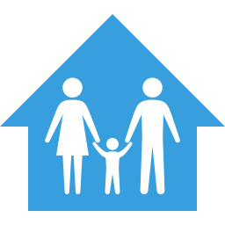
WHY EDGE: SUPPORTING A BETTER QUALITY OF LIFE FOR CUSTOMERS
________
ADVANTAGES FOR HOMEBUYERS
Objective
Utility bill savings that can be repurposed for better quality of life
To empower homebuyers to benefit from utility savings that can be repurposed and provide financial protection while offering a more comfortable lifestyle and inspiring a sense of doing “the right thing” for the planet.
Better thermal comfort
Pride in green achievement
Less chance of late payments or loan default
Potential better resale value
Notes:
End users will enjoy a better quality of life – whether they be home buyers, office tenants, or even retail shoppers.
Utility bill savings can be repurposed for a better quality of life, or an investment into other areas, such as education.
Overall, end users experience better thermal comfort.
Home owners, renters, and tenants can feel pride in protecting the environment.
Savings from utility bills mean less chance of late payments or loan default, which protects both home owners and banks.
Buildings have a potential for higher resale value.

Slide 9
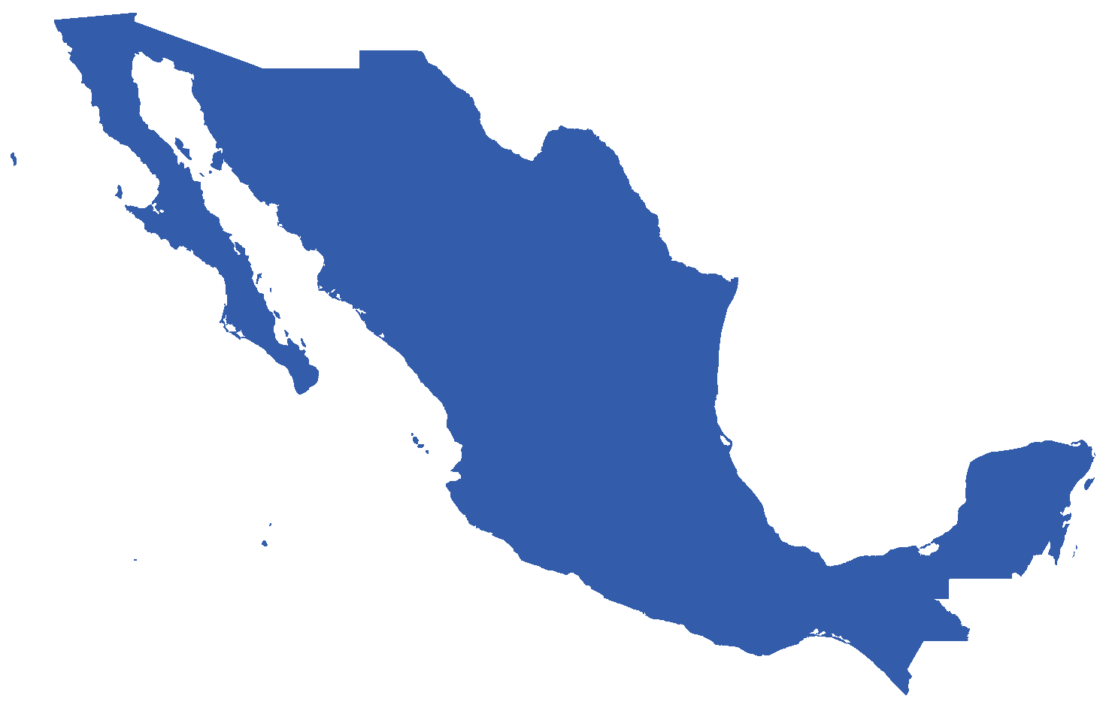
THE INVESTMENT OPPORTUNITY FOR CERTIFIED
GREEN BUILDINGS IN MEXICO
________
1,100 LEED projects either registered or certified
Eighth worldwide in project count
16 million square meters certified
GREEN LEADER
SUMe – Mexico’s green building council
Government initiatives
EcoCasa and Infonavit
LOCAL PROGRAMS
IFC projects a $30 billion investment opportunity through 2030
Potential for 170,000 green residential units through 2030
LARGE OPPORTUNITY
Source: IFC’s EDGE Green Building Market Intelligence
Notes:
Buildings are a tremendous investment opportunity – globally as well as locally.
Here in Mexico, the green building market is experiencing rapid growth. Over 1,100 commercial projects are either registered or certified with LEED certification. Mexico is a global green leader, ranking as the seventh country in the world for LEED-certified projects, which really means it is the number one among emerging markets. The country has 16 million square meters of green floor space.
This is due to strong local programs, with a very active green building council in SUMe.
As you are well aware, progressive government policies have led to the most innovative green mortgage program in the world through INFONAVIT, which has benefited millions of low-income residents. Tens of thousands of energy-efficient homes have been brought onto the market annually through Sociedad Hipotecaria Federal’s EcoCasa program.
This momentum leads to a large opportunity. IFC projects a $30 billion investment opportunity in green buildings through 2030 with a potential for 170,000 green residential units.

Slide 10
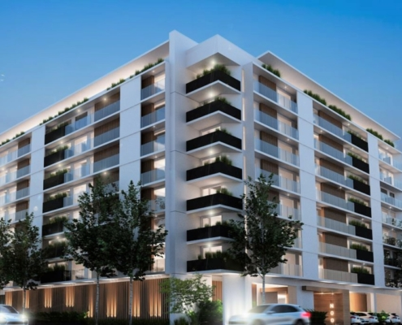
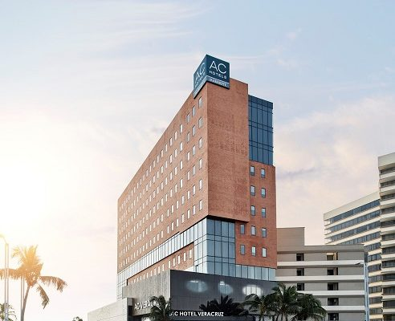
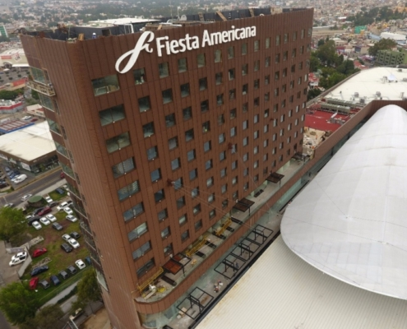
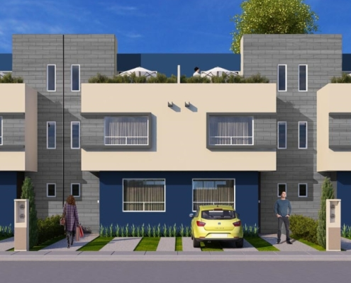
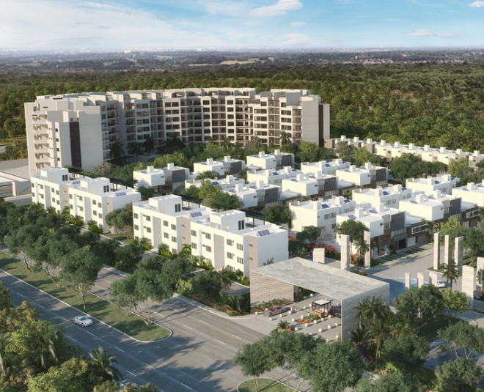
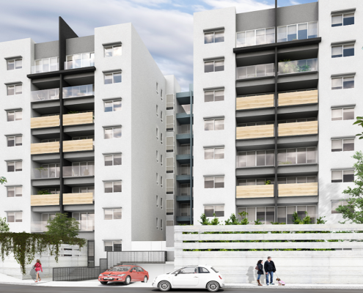
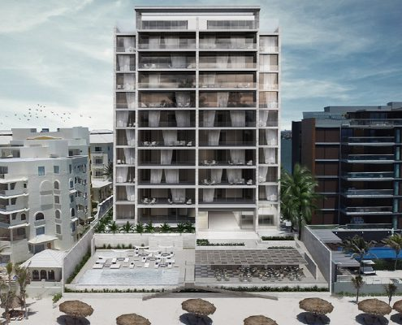
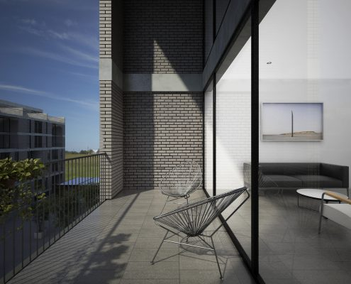
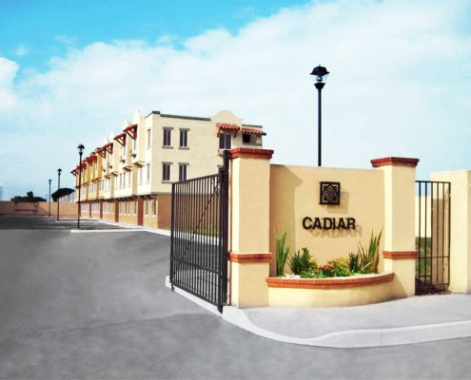
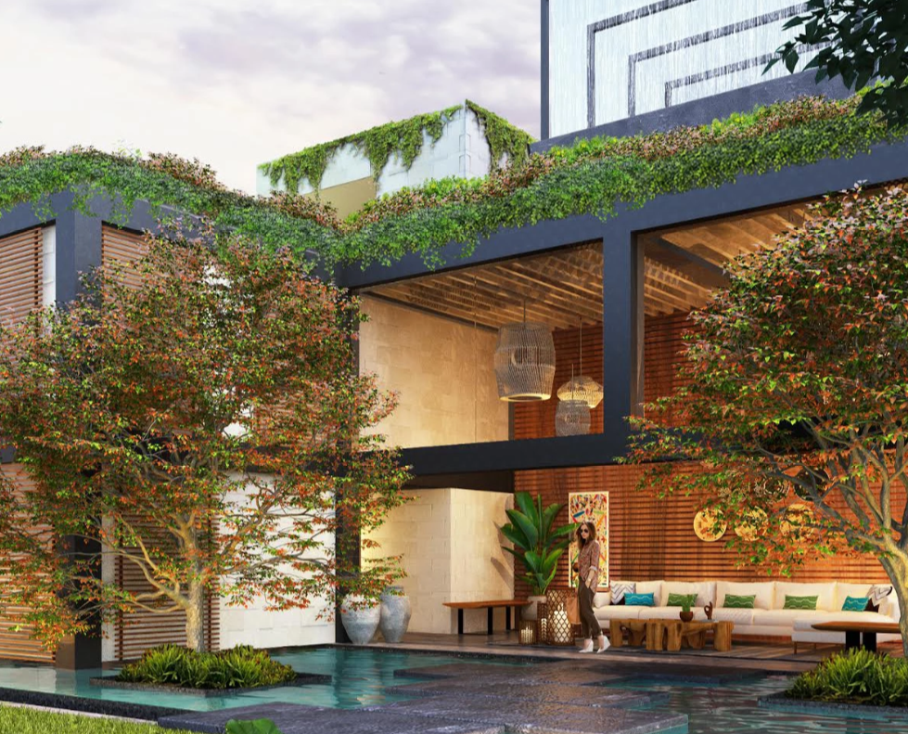
MOMENTUM IS BUILDING FOR EDGE IN MEXICO
Revolucion 757
By FICADE
AC Hotel by Marriott
By Grupo Posadas and Fibra
Fiesta Americana
By Grupo Posadas and Fibra
Villas del Fresno
By Paladin Realty/Casas Krea
Zivalam
By Grupo IKON
Acalli
By Promotora Vivela
KAANA
By Metric Development Group
Cumbres Residencial
By Lares Desarrollos
Real Granada
By VINTE
Bloom Tulum
By BCG
Notes:
Momentum is building for EDGE in Mexico.
More than 546,000 square meters of floor space have been either registered or certified by such early adopters as Vinte, FINSA, and Grupo Posadas.
There are over 1,500 projects uploaded into EDGE, which we consider “early pipeline.”
Of these, 22 projects are actively looking for green financing.
We’re further engaging with the market through our attendance at the ADI Real Estate show this week and again at Greenbuild Mexico in June.

Slide 11
HOW CAN developers CHOOSE THE MOST COST-EFFECTIVE OPTIONS TO DESIGN GREEN? AND How will end customers recognize the value?
Notes:
So, now you may ask – how will you recognize a building as green? How will your clients know how to design a green building? And how will end buyers – whether home owners or commercial tenants – recognize the value of a green building?
Before, it was difficult to know the best way to build green.
There wasn’t an easy way to figure out which green ideas would work the best, and how much they would cost.
There was a need to know the numbers, but no way to find them.
The time was right for a solution that could measure how to turn an ordinary building into a high performing one – before it’s been built.
IFC created EDGE to address challenges that emerging markets face and implemented a third-party verification system to ensure benefits are passed onto consumers and credibly reported to investors, policy makers, and standard-setting bodies.

Slide 12
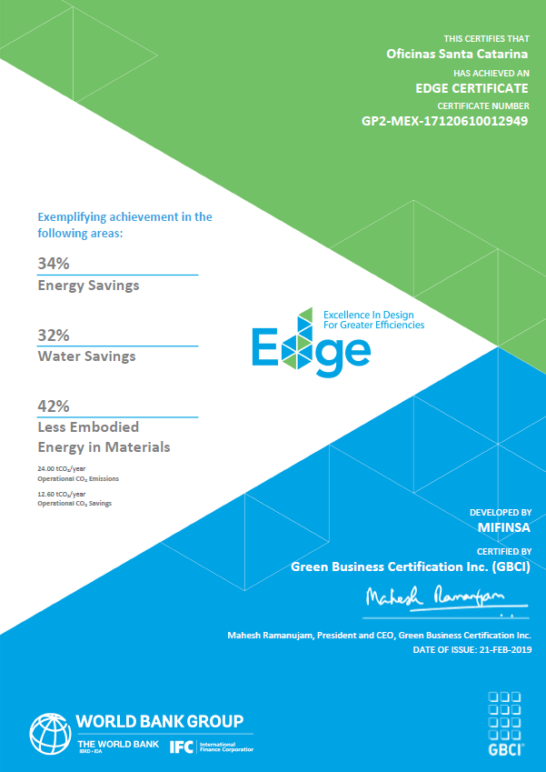
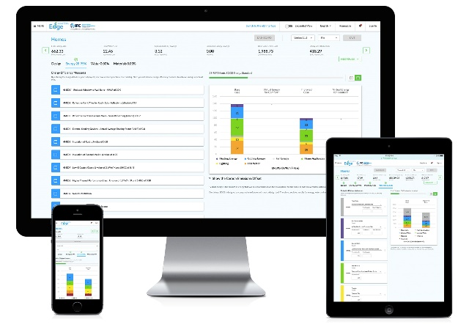
The SOLUTION IS EDGE
________
① FREE SOFTWARE
② ACHIEVABLE STANDARD
③ verified green label
20%
Notes:
The solution is EDGE, which stands for “Excellence in Design for Greater Efficiencies.”
EDGE consists of three components:
First, the free software helps you choose the most cost-effective ways to build green. The software is free and can be accessed from the EDGE website.
Second, EDGE is an achievable green building standard with a 20 percent resource-efficiency criteria.
And third, EDGE is a certification system to verify and reward green building projects through a green label.

Slide 13
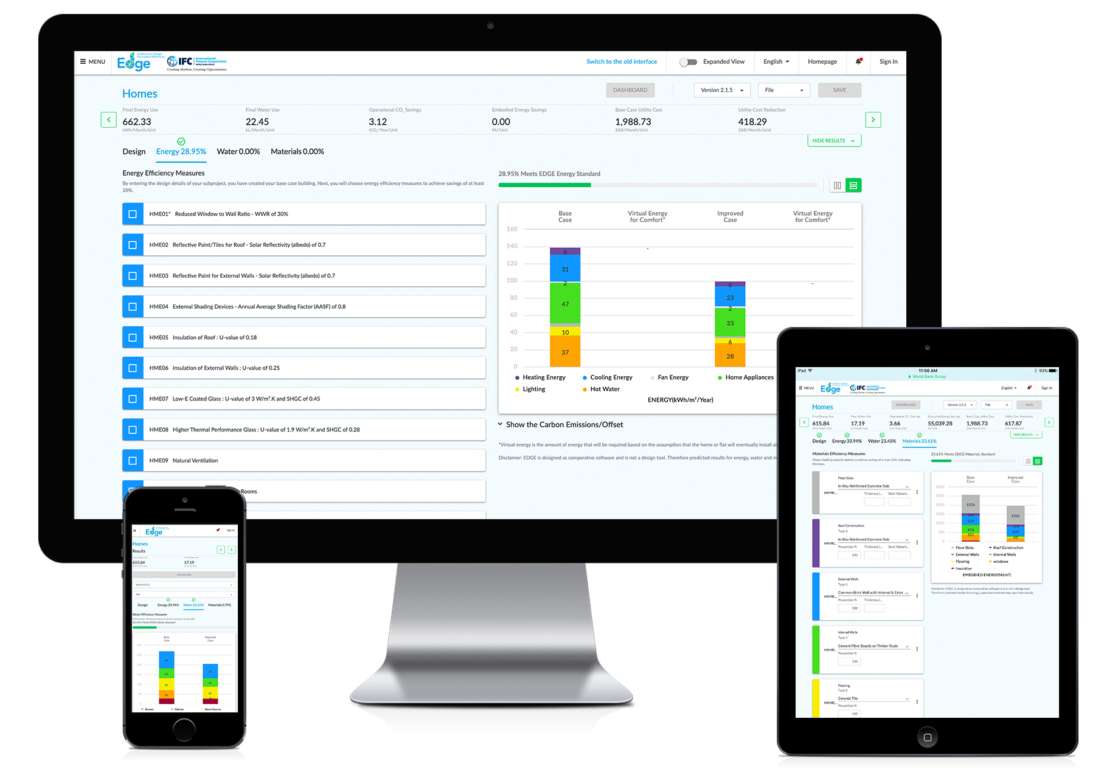
THE FREE SOFTWARE SHOWS HOW TO CUT BACK ON THE RESOURCE INTENSITY of A Building’s design
________
Notes:
The EDGE software is the first of its kind in the world.
The complexity of the application is hidden beneath the user interface, making it easy for you to cut back on the resource intensity of your building designs.

Slide 14
EDGE is available across all sectors, for buildings of all vintages
________
Existing Buildings & refurbishments
New Buildings
Portfolio certifications
Homes
Hospitality
Hotel
Serviced Apt
Resort
retail
Department store
Shopping mall
Supermarket
Big box store
Food store
Airport
Offices
Hospitals
Hospital
Clinic
Nursing home
Education
Pre-school
School
University
Sports facility
Religious facility
Industrial
Warehouse
Light industrial
Notes:
EDGE certification is possible for new and existing buildings, suiting a variety of typologies.
Multiple projects can be certified with a portfolio approach, to transform a company’s business model and maximize profits.

Slide 15
THE edge STANDARD Focuses on THREE CATEGORIES OF resource efficiency
________
20%
20%
20%
20%
20%
MATERIALS
ENERGY
WATER
Further resource: EDGE Methodology
Notes:
To reach the EDGE standard, a project must reach 20 percent savings in energy use, 20 percent savings in water use, and 20 percent less embodied energy in the construction materials, as compared to a local baseline.

Slide 16
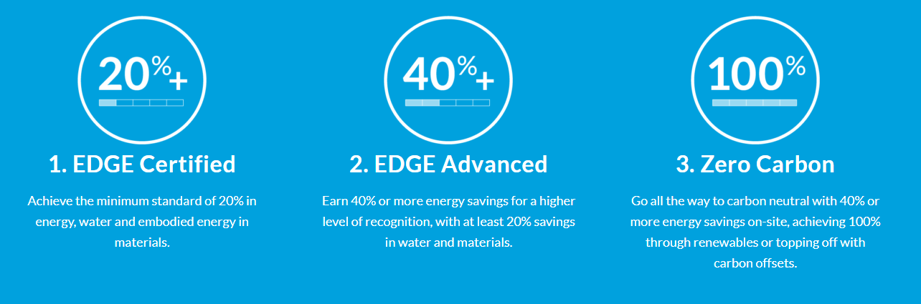
there are three ways to certify. Reach at least 20% savings in water and materials, then choose Your energy savings. ________
Notes:
All EDGE-certified projects protect natural resources and save on operational expenses.
EDGE Advanced and Zero Carbon are opportunities for builders to aspire to even higher levels of certification.
EDGE supports the ambitions of Architecture 2030 and the World Green Building Council for new buildings to be zero carbon by 2030 and all buildings to be zero carbon by 2050.
The “Advancing Net Zero” initiative of the World Green Building Council aligns with the Paris Agreement to keep rising temperatures well below 2 degrees Celsius.

Slide 17
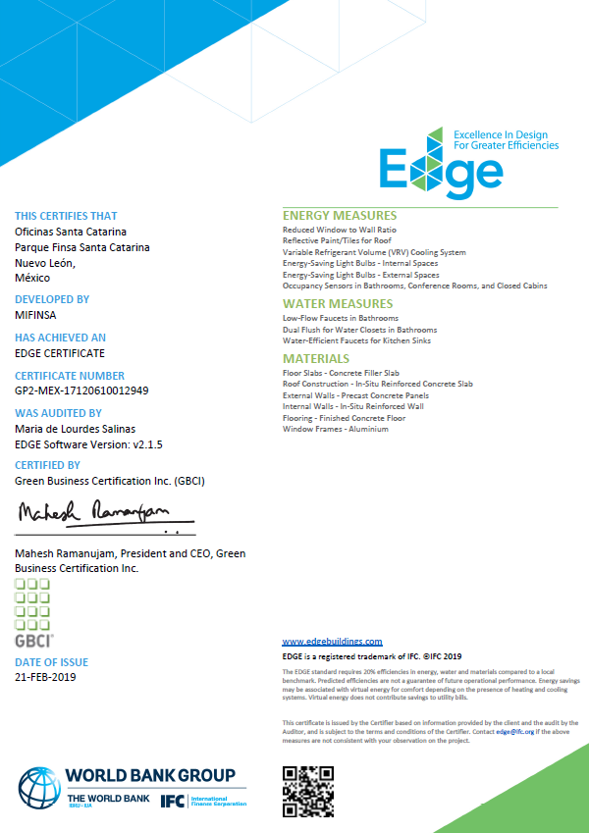
AN EDGE certificatE reduces reputational risk and CAN BE USED AS A VERIFICATION INSTRUMENT to simplify compliance
________
Notes:
If your project meets or exceeds the standard, it can be certified for a modest fee.
Each certificate lists the percentage savings and the measures utilized to achieve the green savings.
EDGE certification helps to communicate benefits among investors, developers, and end users. The certificate verifies the claim and serves as a common language. This greatly simplifies your compliance costs.
In this way, a financial institution doesn’t need to introduce new due diligence measures to recognize green buildings on its books.
When it comes to residential projects, EACH unit receives its own green certificate, which can then be used for green mortgages.
Certification also reduces reputational risk as it is the only verifiable way to communicate value between all the stakeholders in the construction value chain.

Slide 18
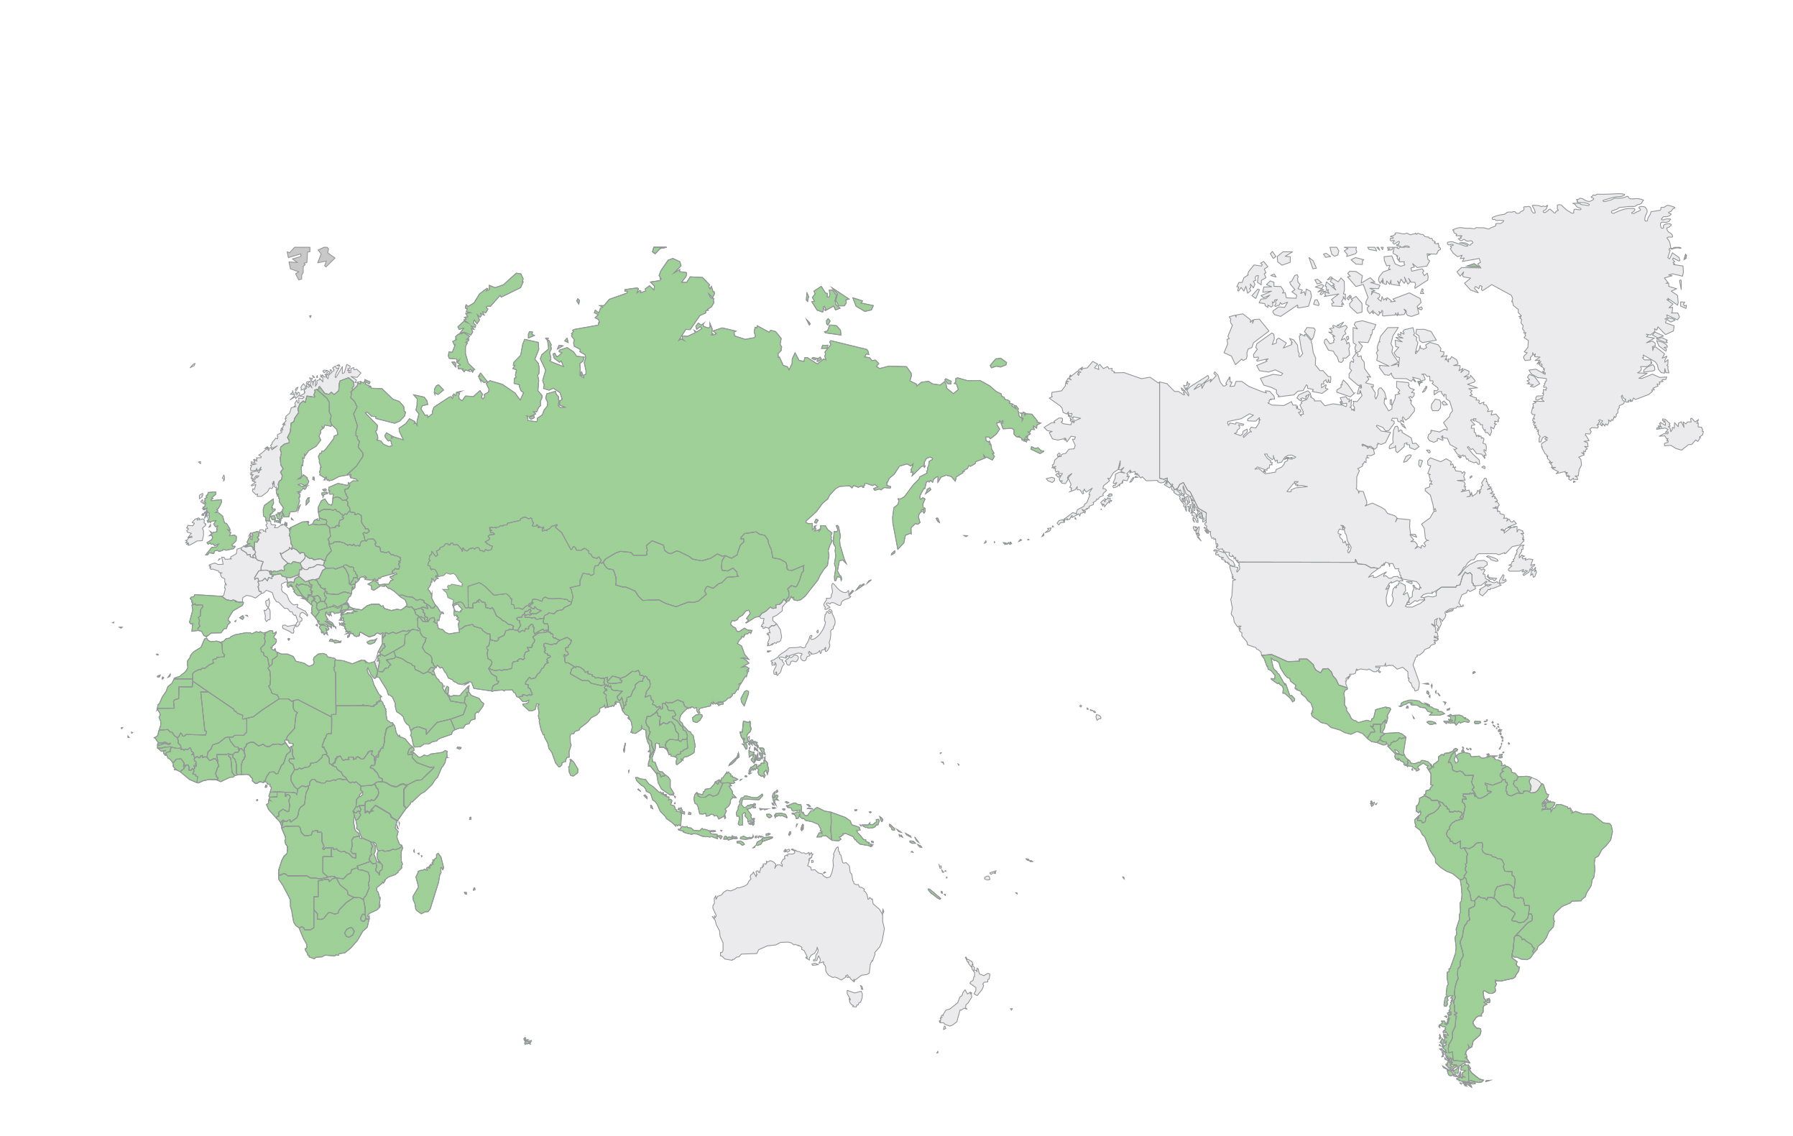
EDGE IS AVAILABLE IN MORE THAN 150 COUNTRIES, INCLUDING MEXICO
________
EDGE is focused on emerging markets because of the World Bank Group’s mission.
Notes:
EDGE is available for buildings designed in more than 150 countries, including Mexico.
There are country-specific certify pages on the EDGE website where you can find relevant information for your market.

Slide 19
HOW EDGE IS DIFFERENT THAN OTHER CERTIFICATION SYSTEMS ________
Financial calculator
Simplified compliance
Reduced processing
Easy impact reporting
Cost-effective
World bank group brand
Notes:
EDGE is different than other certification systems.
You’ll see first-hand how the EDGE software calculates the incremental cost and ROI for green measures – a unique feature among certification systems.
EDGE simplifies compliance by focusing on just three parameters: energy, water, and materials, with a one-stop shop for the entire design and certification process.
EDGE streamlines the compliance process, with global standard-setting bodies ensuring certified projects conform to green finance requirements. It also gives you one standard that you can apply across your entire portfolio, still with enough flexibility to tailor solutions for different building types or different climates.
This leads to reduced processing, as loan officers can rely on the EDGE certificate, with easy reporting on impact metrics.
EDGE has simplified reporting for financial institutions or for developer, ensuring that you can get connected with global green finance flows, where impact reporting is a must.
Fast and cost-effective, EDGE makes green certification achievable for all, bringing international cachet to certified projects through association with the World Bank Group’s brand, delivering value to both you and your clients.

Slide 20
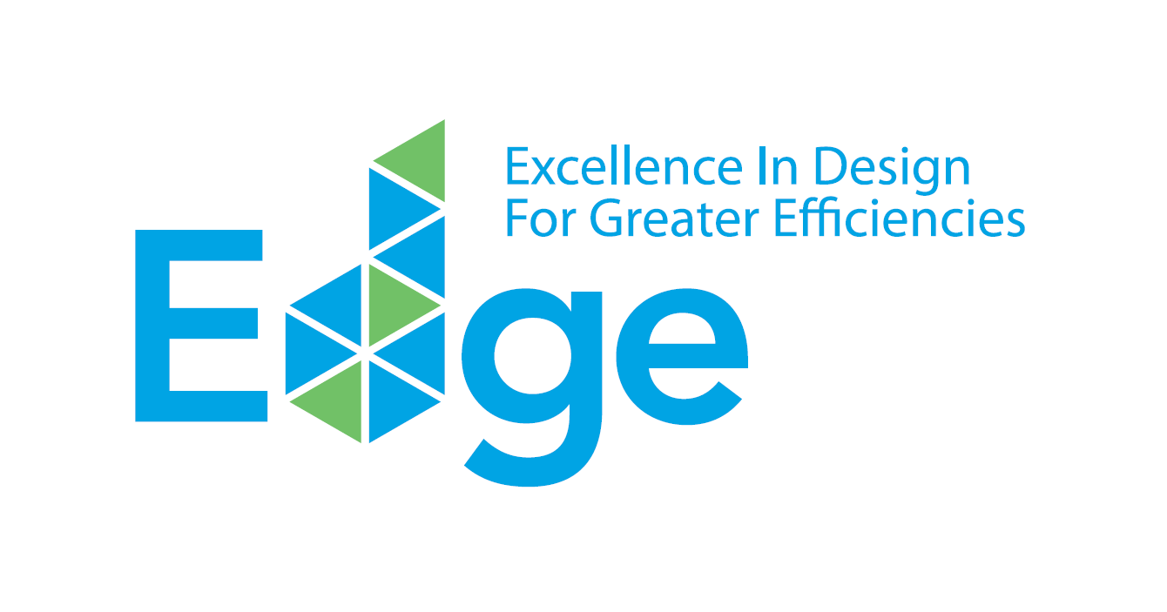
Edge demonstration ________
www.edgebuildings.com
Notes:
We’ll now proceed to a live demonstration of the EDGE software and talk more about the certification process, in addition to sharing a few case studies.

Slide 21
certification WORKFLOW FOR PROPERTY DEVELOPERS
________
Use the EDGE App for self-assessment & project registration
Submit design documents into the EDGE App
Submit as-built documents into the EDGE App
Register
Design
Construction
Operation
Preliminary EDGE Certificate
Final EDGE CertificatION
EDGE co-marketing and project study for sales promotion
Preliminary Certificate serves as proof of compliance for the investor
Final proof of compliance
Impact reporting for the project
Model unit showcase opportunity
Notes:
Let’s look more closely at the EDGE certification workflow. EDGE projects receive both a preliminary EDGE certificate at the design stage, and final EDGE certification at the post-construction stage. A building currently under construction can skip the preliminary process and go straight to final certification.
As soon as the certificate is issued, a project study can be submitted by the client for publishing on the EDGE website, with social media coverage provided across EDGE channels. The EDGE logo and brand guidelines are also provided for investor and/or sales promotion purposes.

Slide 22
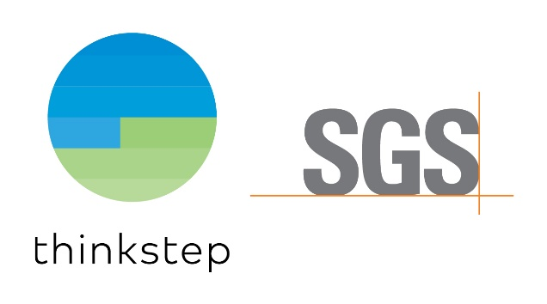
EDGE certifiers OFFER two different business models TO OFFER Developers a choice tHAT best meetS THEIR needs
GBCI is the same entity that offers LEED certification.
Sliding scale fee, but capped for projects larger than 50,000 m²
Requires an independent auditor (appointed by GBCI or the client)
Fee for auditors independently negotiated
CERTIFICATION | PRICE PER M² | MINIMUM
0-25,000 FLOOR AREA (SQM) | $0.27 | $2,250
25,000-50,000 FLOOR AREA (SQM) | $0.22 | $6,750
> 50,000 FLOOR AREA (SQM) | — | $11,000 Flat Fee
The consortium of thinkstep and SGS sets the global benchmark for quality and integrity.
Flat fee for projects with one typology that includes both audit and certification
Discounts available for hiring an EDGE Expert or portfolio certifications
Pricing includes travel and incidentals
PROJECT TYPE | CERTIFICATION | DESIGN AUDIT | FINAL AUDIT | TOTAL
Residential (up to 3 unit types) | $2,400 | $4,000 | $4,000 | $10,400
Commercial (single end use) | $2,400 | $4,000 | 4,000 | $10,400
Notes:
In Mexico you have a choice between two certifiers with different business models.
GBCI, the operational entity of the U.S. Green Building Council that also offers LEED certification, has a sliding scale that requires an independent auditor with separately negotiated fees.
The consortium of thinkstep-SGS has a flat fee for projects with one typology, where both the audit and certification fee are included.

Slide 23
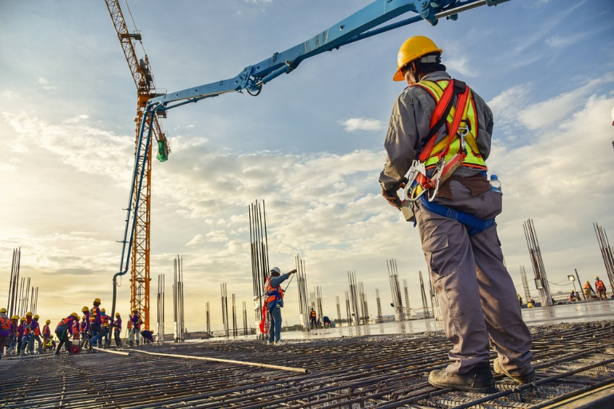
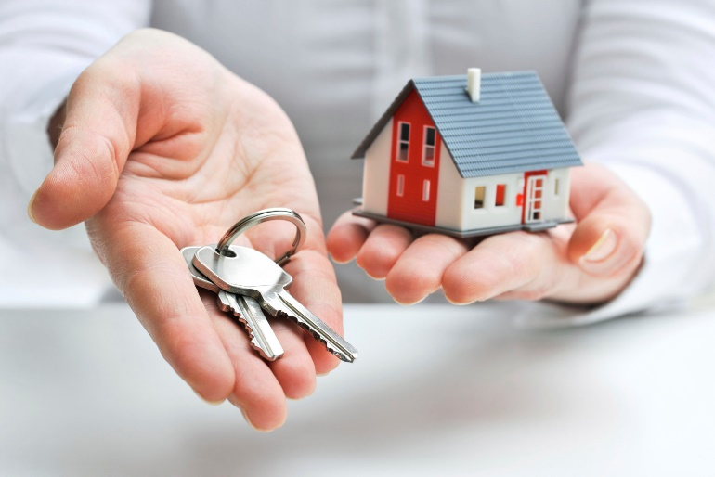
HOW CAN BANKS CREATE INNOVATIVE AND LOW-RISK Financial products for green buildings?
Cross-selling opportunity
green construction
green mortgages
Capital markets
Create awareness of affordability
Build technical capacity for developers
Recognize lower risk rating
Offer discounted financing rate
Increase allowable loan ratio
Include utility savings in homebuyers’ income
Attract more responsible homebuyers with less risk of late payments and loan defaults
Issue green bonds for new portfolio
Securitize portfolio as collateral
Attract new investors
Expand into new markets
Develop new products: Leasing, REITs
Notes:
Now that we have established a green building definition, and the business case for investing in green buildings, let’s take a look at three main categories of financing: green construction finance, green mortgages, and capital market products.
With green construction finance, the focus is, of course, on developers. What developers need is awareness of the benefits of green buildings and the technical capacity to make them happen.
From the bank’s side, you can incentivize the adoption of green practices by providing a lower risk rating for green buildings, which won’t become stranded assets when climate policies are increased.
You can start by rewarding developers now for green adoption by providing a discounted financing rate – no matter how small – which we’ll review together in our case studies.
Green mortgages allow you to cross-sell with construction finance. You can work with the same developer and finance the same property twice. Developers can drive home buyers to you for mortgages, with verification provided through a copy of the EDGE certificate.
With home buyers, a green home can be slightly more expensive than regular construction. You can increase your allowable loan ratio and qualify home buyers, as utility savings can be redirected into a larger loan payment.
One of the ways you can do this is to include utility bill savings in disposable income and adjust the debt to income ratio for the home buyer.
In capital markets, you can raise a green bond to finance a new portfolio of green buildings. Once you have a stock of certified buildings, you can securitize them as collateral, as the green certificate provides the same standard that will enable securitization.
You can also introduce new products such as green leasing or REITs.

Slide 24
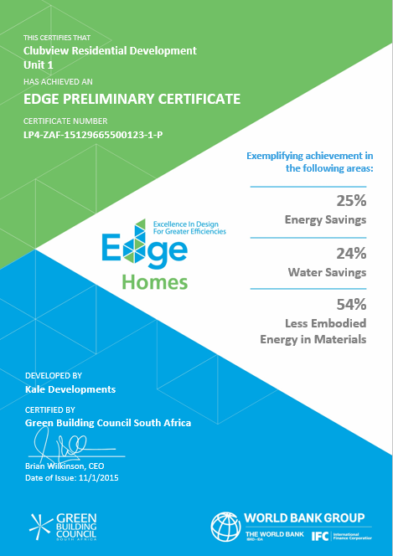
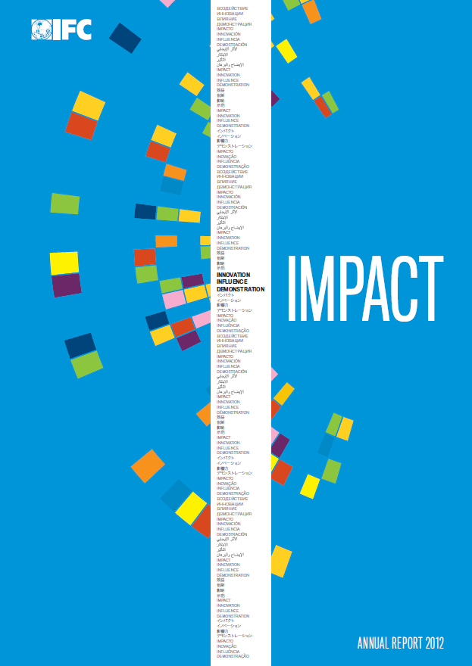
Investment criteria and compliance process
________
Embedded into loan agreement
3-6 months for certification
Certificate proves compliance
Impact
reporting
Green mortgage
Green construction finance
Notes:
Let’s look into some of the best practices for launching a green building investment program.
When it comes to green construction finance, green criteria must be embedded into the loan agreement with clients.
You might consider providing conventional financing at the start of a loan agreement and require a specific time frame – such as a three-month period – during which time the project must be certified. At that point, green financing would be provided. This is the model used by Bancolombia, which we’ll discuss in more detail in a moment.
The EDGE certificate proves the project is verifiably green for green mortgages as well. EDGE reduces your transaction costs by saving loan officers from checking the implementation of technical measures.
Finally, if you are working with IFC or other international investors, you’ll need to report your impacts, which EDGE can easily provide, at both an individual project level and on a portfolio basis.

Slide 25
FOR BANKS ROLLING OUT A GREEN BUILDING PROGRAM, HIRING Edge expertS IS BEST PRACTICE
ROLE OF EDGE EXPERTS:
Levels of technical advice possible:
① Embedded within the certification process
① Basic or advanced services for developers
② Provide design advice to developers and
fulfill compliance requirements
② Training for investment officers
③ Ensure certification awarding
within the requisite time frame
③ Comprehensive advisory services
agreement with IFC
Notes:
Earlier I mentioned that we recommend you develop a close relationship with a cadre of dedicated EDGE Experts. These are technical advisors who have been trained and accredited by IFC and are a part of a global community of green building professionals.
Experience shows that the best practice is for EDGE Experts to be employed by you and embedded within the process.
As EDGE Experts provide training to your clients, this will ensure quality control across your portfolio.
EDGE Experts also ensure that the certification compliance is executed within the time frame set by your loan agreement.
There are various levels of technical advice possible, some of which are free, and some that require some investment from you.
EDGE Experts can offer basic or advanced services for developers. IFC can also provide training to the bank’s investment officers. You may also choose a comprehensive advisory services agreement with IFC.

Slide 26
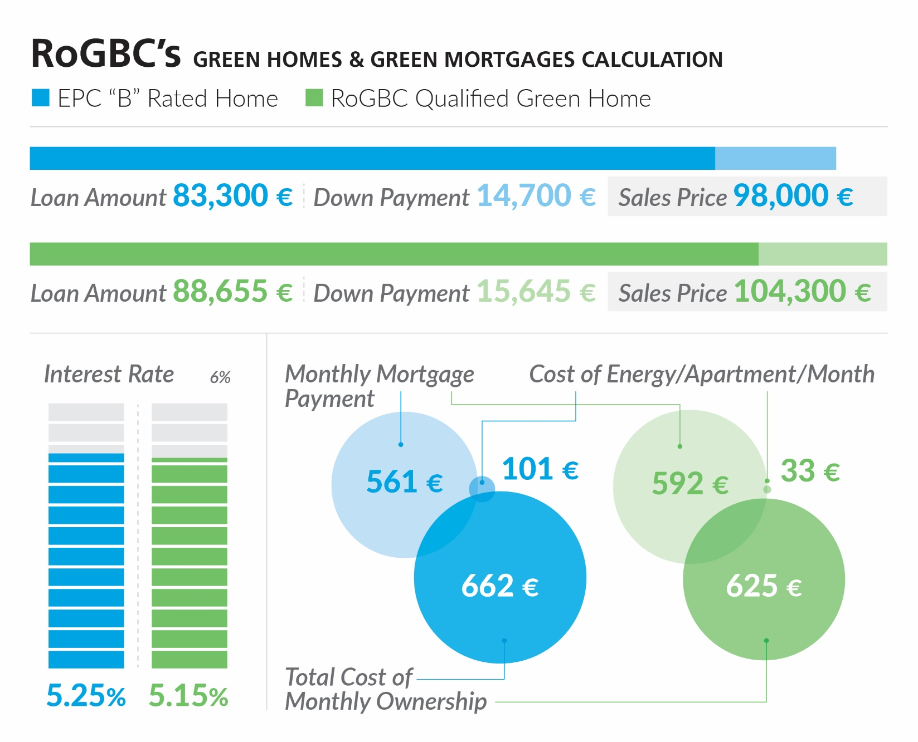
CASE STUDY: ROMANIA GREEN BUILDING COUNCIL (RoGBC)’S
GREEN MORTGAGE MODEL WITH RAFFEISEN BANK
Notes:
Let’s take a look at a few case studies to see how other banks launched their green building investment programs.
First, we have a case study from Romania, where the local green building council worked with Raffeisen Bank to launch a green mortgage product.
You can see the comparison of a home which received an energy performance certificate in blue and a certified home in green. The green home is a little more expensive to cover the cost of the green features. To incentivize adoption, Raffeisen provides home buyers a slightly preferential interest rate.
The home buyer pays the bank a higher mortgage payment (592 euros compared to 561 euros) but the total cost of ownership is lower because of utility bills. The green home buyer’s all-in cost is 37 euros lower (625 euros compared to 662 euros). It’s a win-win for both the bank and the home buyer.

Slide 27
Green mortgage example
 | Standard Building: Standard Mortgage | Green Building: Green Mortgage
Base Purchase Cost | 50,000 | 50,000
Green Measures |  | 1,500
20% Down Payment | (10,000) | (10,300)
Loan Amount | 40,000 | 41,200 | 3%
Rate | 11% | 11%
Term | 20 yrs | 20 yrs
Monthly Payment | $413 | $425
Energy Savings |  | (20)
Net Mthly Payment | $413 | $405 | -2%
Bank Income (Yr 1) | 4,371 | 4,502 | 3%
Additional cost of efficiency measures
Costs can be lowered if EDGE is utilized early in the process
Higher loan Amount
Benefits accrue even on commercial terms, but bank can incentivize adoption
TERMS CAN VARY
WIN-WIN
Lower bills for the borrower
Higher income for the bank
Notes:
This slide is a more generalized version of the same example. Here, you can see the cascade of the green mortgage versus a standard mortgage, and which benefits go to the home buyer and which to the bank.
The benefits accrue even on fully commercial terms (with an interest rate and the term the same for both the standard and green example).
It’s another win-win, with a lower all-in scenario for the borrower and higher income for the bank.

Slide 28
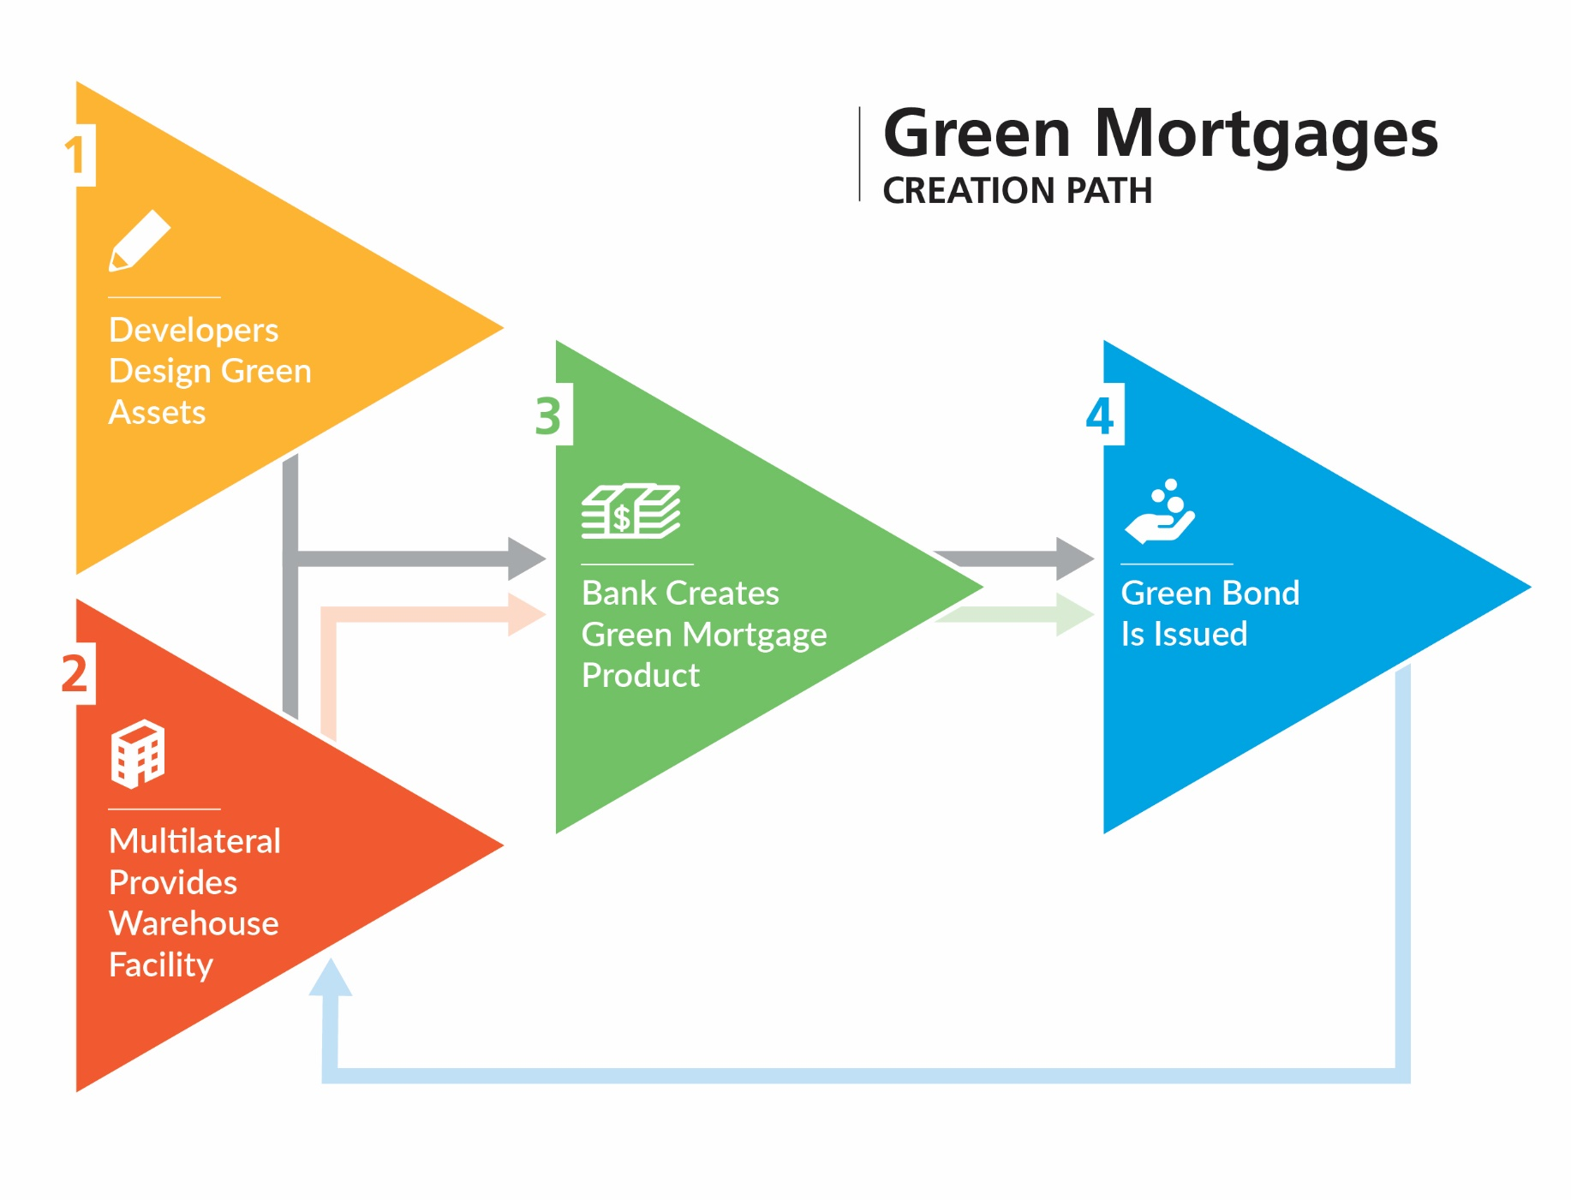
CASE STUDY: BANCO PROMERICA IN COSTA RICA PARTNERED WITH FMO, THE DUTCH DEVELOPMENT BANK, ON A WAREHOUSE FACILITY
Incentives:
Lower interest rate
Longer term
Longer grace period
Notes:
For its green mortgages program, Banco Promerica partnered with FMO to create a warehouse facility to spur green homes in the Costa Rican market.
Promerica encouraged developers to design green assets, then created a green mortgage product to finance those assets, which are supported by the proceeds of a green bond.
You can see a virtuous loop, where one product supports another.
Banco Promerica also provides a construction financing rate at 8.75% compared to a normal rate of 9.25%, with the support of the multi-lateral bank’s warehouse facility.

Slide 29
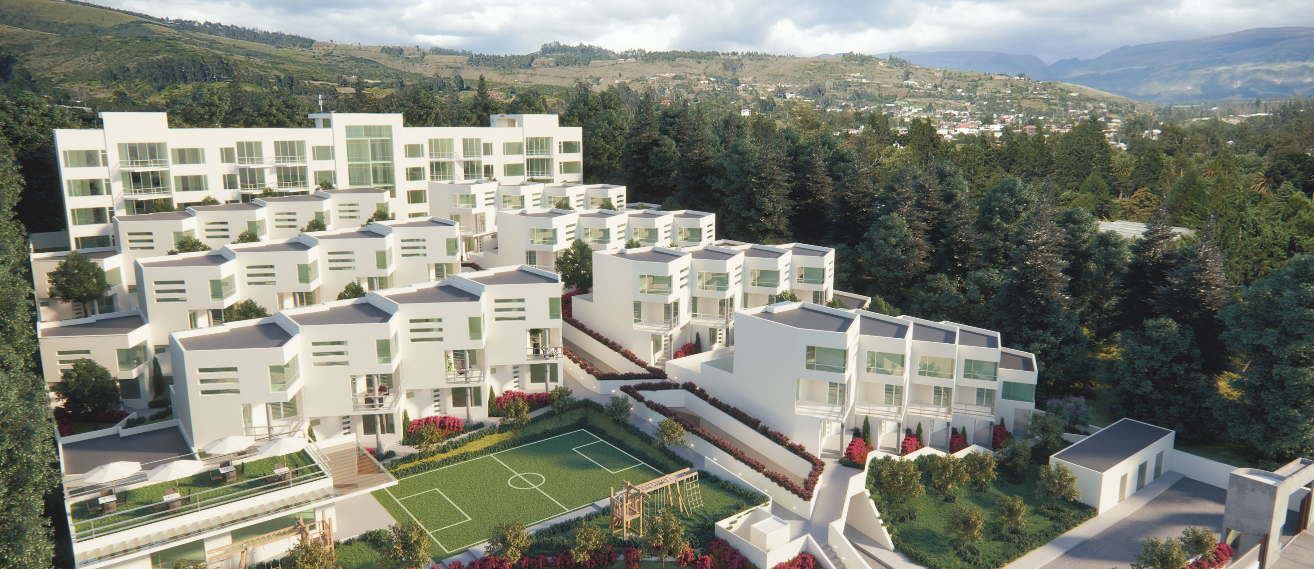
CASE STUDY: BANCO PICHINCHA IN ECUADOR OFFERS FREE EDGE CERTIFICATION, EDGE TRAINING, and technical advisory SERVICES
Notes:
Banco Pichincha in Ecuador offers free EDGE certification for their first crop of projects.
They also offer free training to developers as well as in-house EDGE Experts who serve as technical advisors on projects.

Slide 30
CASE STUDY: DAVIVIENDA OFFERS A GREEN CONSTRUCTION FINANCING RATE AND A PROMOTIONAL OFFER OF FREE EDGE CERTIFICATION
127 LIVING
Notes:
Davivienda in Colombia offers a green construction financing rate and a promotional offer of free EDGE certification. This was important for the bank in order to compete with Bancolombia’s early entry into the market with green financing.

Slide 31
CASE STUDY: BANCOLOMBIA ISSUED GREEN BONDS AND USED ITS OWN RESOURCES FOR GREEN CONSTRUCTION FINANCING AND GREEN MORTGAGES
1. First Bond
2. Own Resources
3. Second Bond
$117M
$175M
$100M
IFC was the sole investor.
1st issuance in Colombia.
17 events with 300 developers, supported by a major marketing push.
$175M invested in green construction financing and green mortgages.
Green mortgages only for EDGE-certified properties.
IFC was not involved.
Oversubscribed 2.8 times.
72 domestic investors.
Objective to achieve better pricing than original bond.
OFFER For developers: variable loan for green construction financing from 0.5% up to 2% less than conventional market rates
OFFER FOR HOMEBUYERS: discounted rate of 65 basis points for the first seven years of the loan
Notes:
Another case study is from Bancolombia, which used proceeds from green bonds as well as its own resources for green construction finance and green mortgages.
The bank was the first in the Colombian market to issue a green bond with IFC as the sole investor, with the proceeds earmarked to green buildings. Its second bond was issued without IFC’s support, which was over-subscribed 2.8 times with 72 domestic investors participating. Bancolombia predicts that investment demand could be 10 to 12 times the original size of the bond.
Bancolombia met with 300 of its developers during 17 roadshow events that it marketed extensively.
The bank offers a generous financing rate of up to 2% less than conventional market rates for construction financing and 65 basis points lower for green mortgages.

Slide 32
EDGE acknowledgments ________
The following major donors have demonstrated their generous support of the EDGE program:
IFC also wishes to express its appreciation to the following donors:
The European Union; the Ministry of Finance of Japan; the Hungarian Export Import Bank; the Canada Climate Change Program and the Department of Foreign Affairs, Trade and Development Canada; the Royal Ministry of Foreign Affairs of Denmark and the Danish Green Growth Fund; the Federal Ministry of Finance of Austria; and the Ministry of Foreign Affairs of Finland. In addition, the support of the GEF-IFC Earth Fund Platform and the Energy Sector Management Assistance Program (ESMAP) of the World Bank helped seed EDGE.
Notes:
We also acknowledge IFC’s donor partners who have made EDGE and IFC’s work in green buildings possible. These governments and institutions are the reason IFC is able to offer the EDGE software application for free, as well as all of our awareness raising and promotional activities.

Slide 33
www.edgebuildings.com
Notes:
Thank you again for joining us today.
We appreciate your interest in EDGE and hope you will join us in transforming the construction market in Mexico.

